Slide 1
Banking Business Case Analysis for Term Deposit Prediction
Case Study presented to NeoStats
Presented by:
Ananya Pareek pareek.ananya1@gmail.com

Slide 2
INTRODUCTION
Problem Statement:
A major bank in the Middle East seeks to
identify customers most likely to opt for a term deposit.
TOOLS USED:
Python (Jupyter Notebook) Excel
PowerPoint
Objective:
Analyze customer data and marketing campaigns to provide actionable insights and predictive modeling.

Slide 3
PROCESS MAP
1
2
3
DATA PRE- PROCESSING
Steps consists of handling
negative values, NULL values and other pre-processing steps
DATA ANALYSIS
Solved all the analysis questions present in the case study for further work
DATA VISUALIZATION
Steps consists of handling negative values, NULL values and other pre-processing steps

Slide 4
1
2
3
TEST-TRAIN- SPLIT
Split the data in 80:20 for training our model to find
DATA MODELLING
Selecting and training a model based on the dataset
EVALUATION
Calculating confusion matrix, f1 score, accuracy, precision and using feature engineering to modify the results

Slide 5
DATA PREPROCESSING
Data Collection
Step 1: Data collection and analysis process perfomed on the dataset provided by NeoStats
Merging the Dataset
Step 2: Merged the two datasets based on the 'Customer_number' column for futher pre- processing of the data
Studying the Datasets
Step 3: Identifying NULL values, skewness, replacing special characters like (['?', ' ', '\\','??','??//','????','//??','???'] with NaN and further replaced it with mean, median and mode and further studied the data types.
Replacing certain Values
Step 4: Included mobile and cellular in the same category, tel and telephone in same category and some other known details

Slide 6
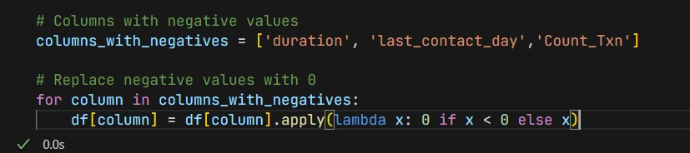
Handling Negative Values
Step 5: There were total 4 columns which had negative values namely: Balance, Duration, Count_Txn and last_contact_day, since negative balance is possible in banks because of overdrafting and multiple other reasons so kept it untouched, and replaced the 6-7 negative values which are not usually possible with 0 by using the lambda function

Slide 7
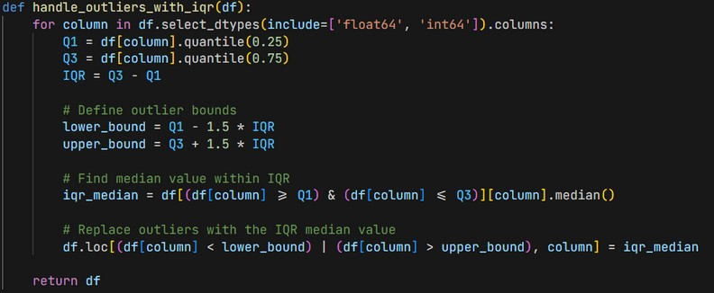
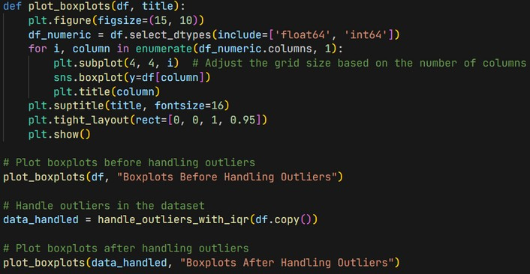
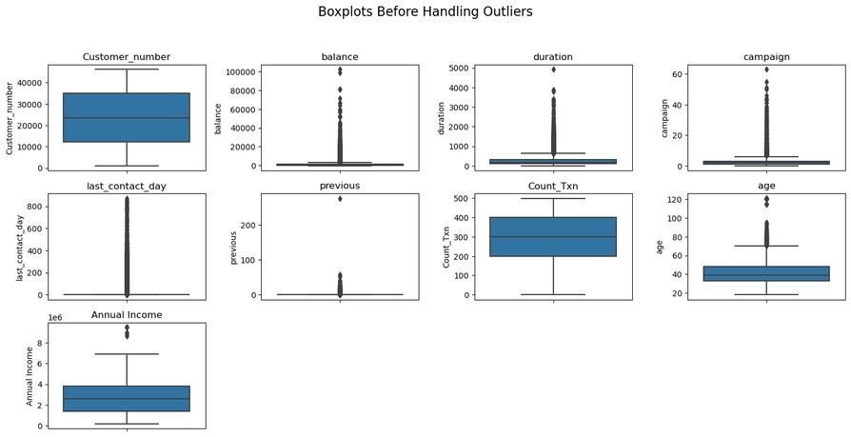
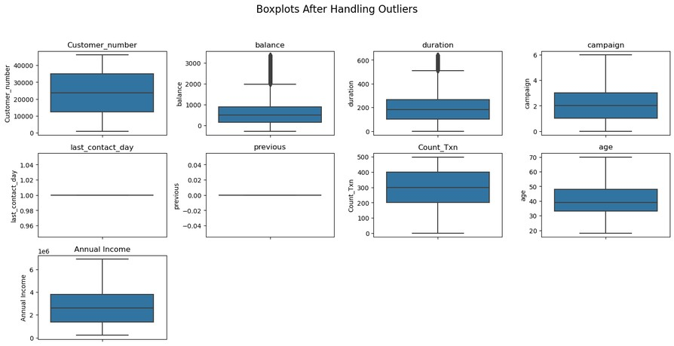
Handling Outliers
Step 6: There are several outliers in the dataset provided, so outliers needs to be handled so that model can be trained with proper outcome, for this IQR ( Inter Quartile Range ) has been used, and all the outliers has been replaced with IQR meadian values.

Slide 8
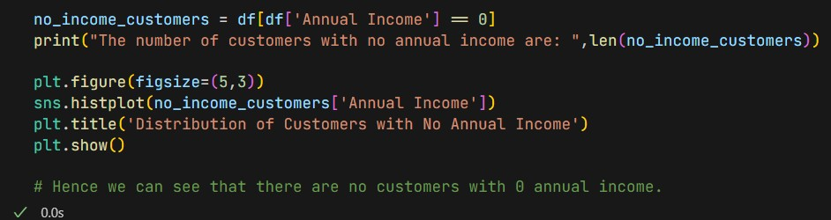
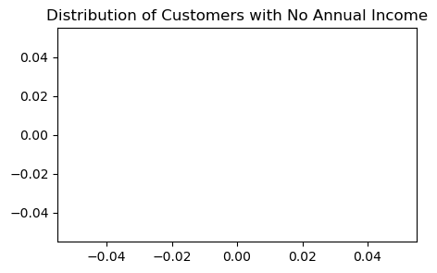
ANALYSIS AND VISUALIZATION
1. Income Insights: How many customers have no annual income? Plot and present the data distribution of these customers
In the column Annual Income, there aren’t any NULL/0 values so the graph is empty here.

Slide 9
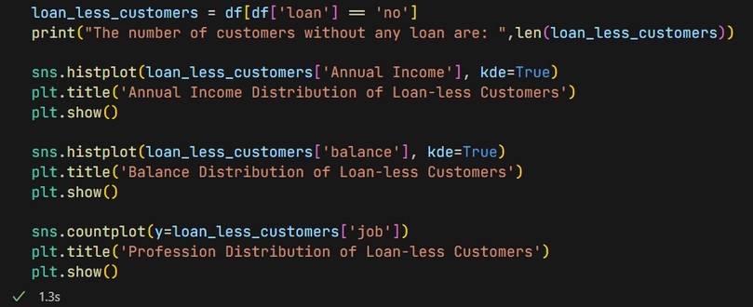
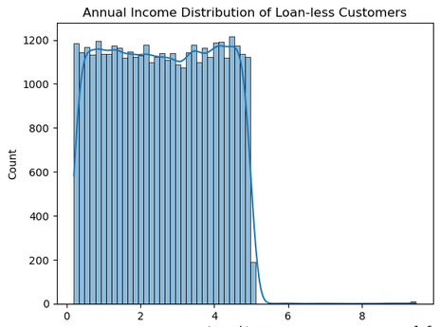
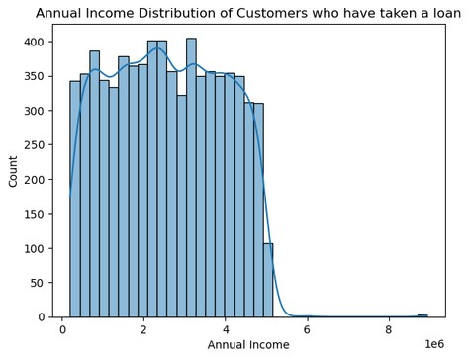
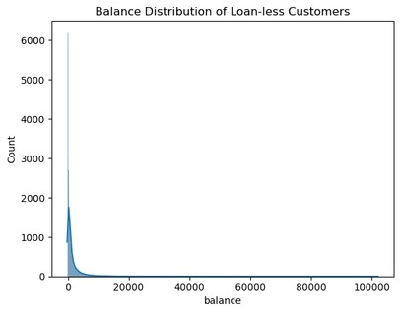
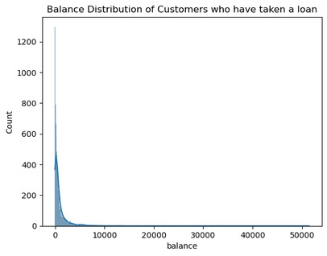
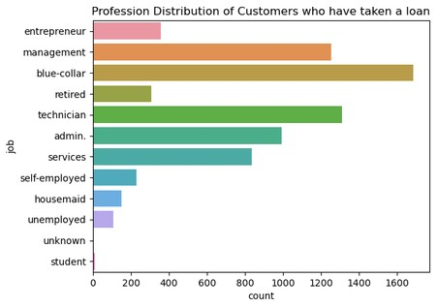
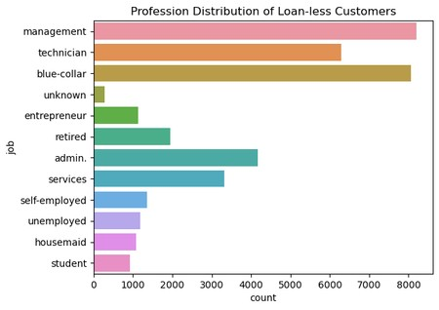
2. Loan-Less Customer Profile: Filter out customers who don’t have any type of loan. Plot the distribution of their Income, balance, and profession. How do these metrics differ from those with loans?

Slide 10
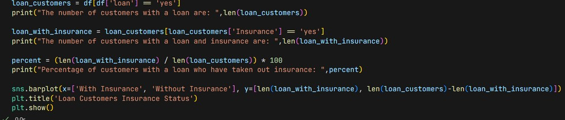
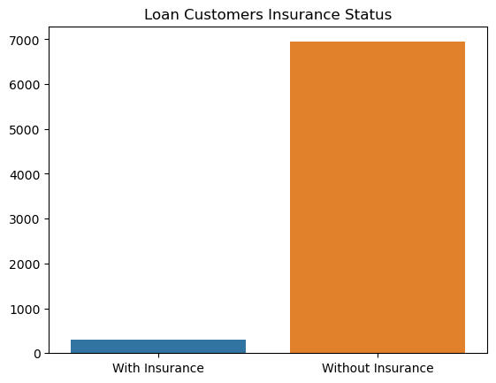
3. Loan and Insrance analysis: Calculate the percentage of customers with a loan who have taken out insurance. Visualize this data and discuss potential implications.
Only 4% of the population of people who have taken loan has taken insurance, this also reflects how the income distribution has affected this huge disparity in perecentage, thus reflecting how income has a potential implication in it.

Slide 11
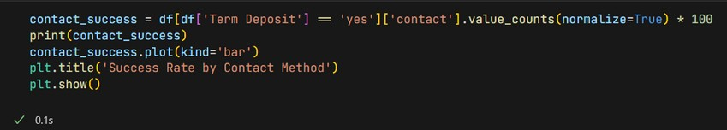
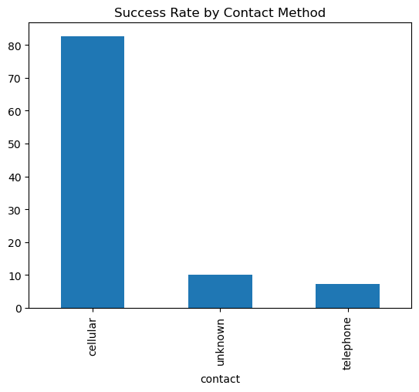
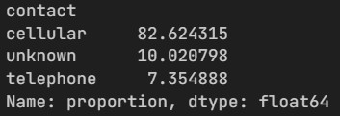
4. Communication Strategy Insights: Analyse and summarize the best Contact method (with the highest success percentage) to contact people to ascertain the status of term deposit subscriptions.

Slide 12
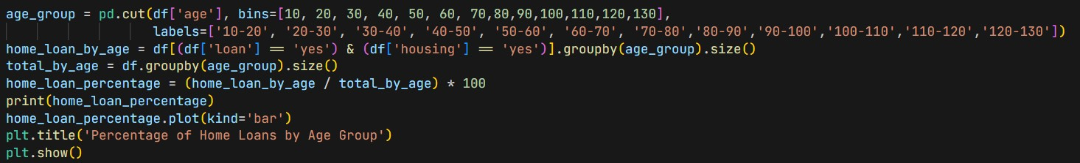
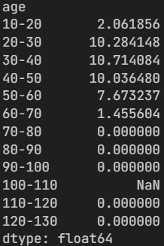
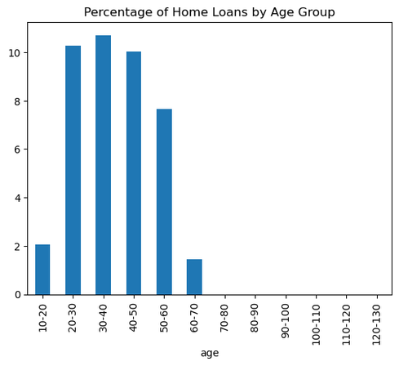
5. Age and Home Loans: Determine which age group has the highest percentage of home loans. Present this data visually and discuss possible reasons
The Highest percentage is of the people who are in the age group of 30-40 followed by 20-30, its highly because people’s income become stable during this stage of life and they feel comfortable in buying their high pay needs and with the ease of satisfying and completing the loans

Slide 13
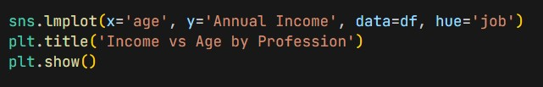
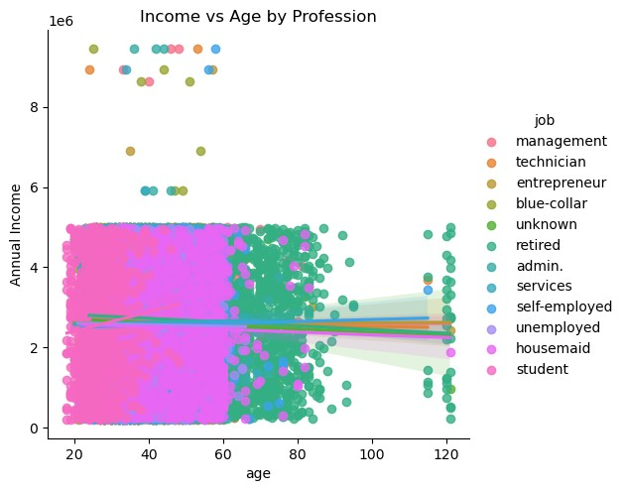
6. Income and Age Relationship: Investigate any relationships between annual income and age group. Use appropriate plots and statistics to present the findings
It is often seen that with age, often the annual income tends to increase, but it highly depends on the profession of the customer, while students seem to have less income, blue-collar, retired, self- employed are tending to have more income with age.

Slide 14
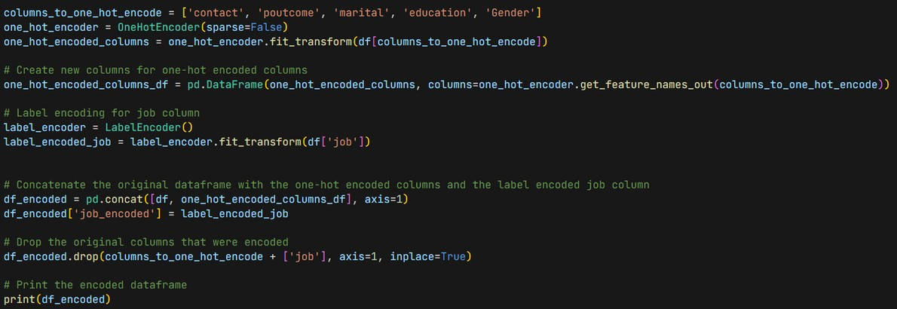
ENCODING
Five cols namely: ['contact', 'poutcome', 'marital', 'education', 'Gender'], here one hot encoding has been performed for conversing of categorical
data.
In cols: ‘contact’, Label Encoding has been
performed for converting categorical data for further processing
In four cols namely: ['Insurance', 'housing', 'loan', 'Term Deposit'], yes and no has been replaced with binary values

Slide 15
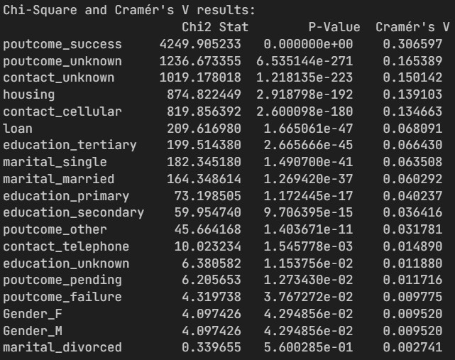
1. Term Deposit and Related Variables: Identify variables strongly related to Term Deposit. Discuss your approach when the variable is categorical. Which tests or metrics will you employ?
Heatmap has been made here, to identify the correlation matrix an the highly correlated values, taking term deposit as the point of identifier, I have calculated the values which are highly correlated to it.
Chi-Square and Cramer’s V are the two metrics used here for determining further correlation.

Slide 16
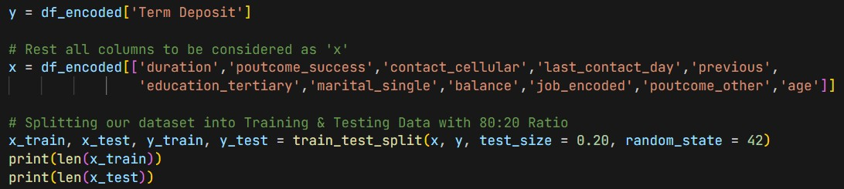
2· Train a prediction model of your choice to estimate the probability that a customer will opt for a term deposit. Adhere to an 80:20 train:test split. Report and present the model's performance metrics on both the train and test datasets.

Slide 17
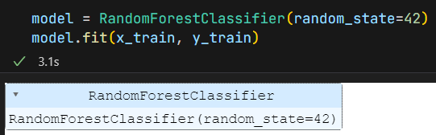
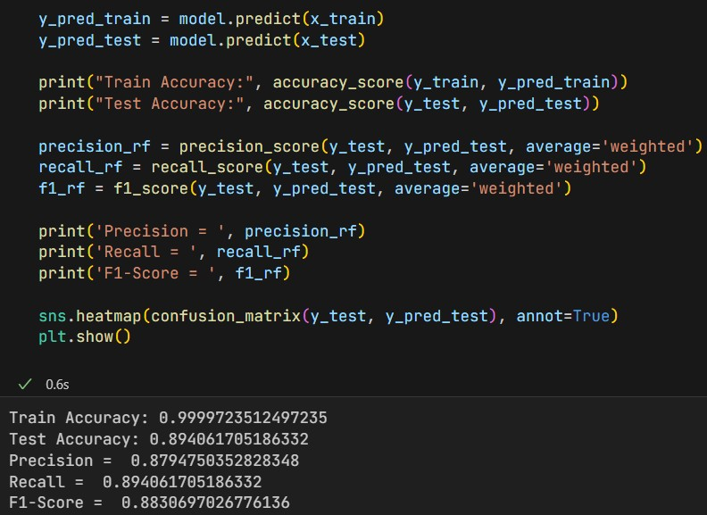
Here, I have used Random Forest Classifier because:
It’s a quick, interpretable model that
performs well across many types of data.
Its an ensemble method that combines multiple decision trees, which helps to
reduce the risk of overfitting, especially in comparison to individual decision trees.
It usually requires less hyperparameter tuning compared to models like XGBoost, making it a more straightforward choice when you need a model that works well out of the
box.

Slide 18
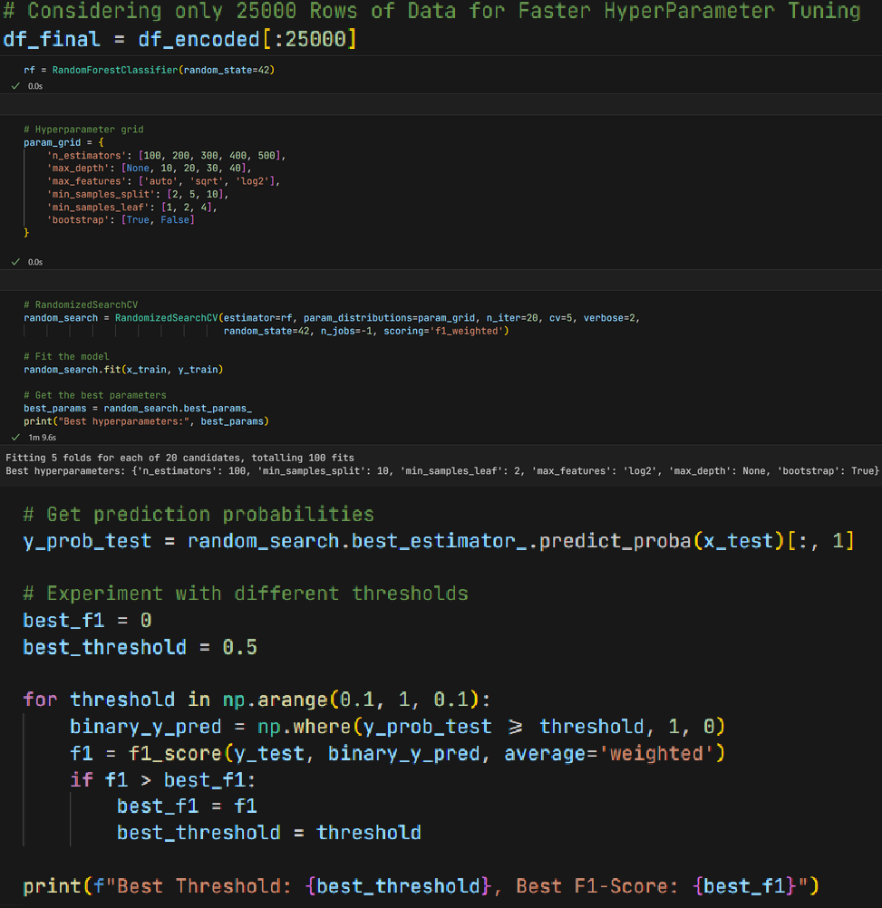
HYPER-PARAMTER TUNING
3. Discuss potential methods or approaches to enhance model performance. This could include feature engineering, different algorithms, or refining the data preprocessing steps.
Here, out of 45k, I have used 25k rows for faster hyper-parameter Turing, and have selected 20 iterations for better results along with 6 param grids.
Since, classification model has been used so F1- score has been taken along with different possible values of thresholds for better results.
Along with Hyperparameter Turing, outliers has also been handled during data pre-processing step, thus improving the model performance.

Slide 19
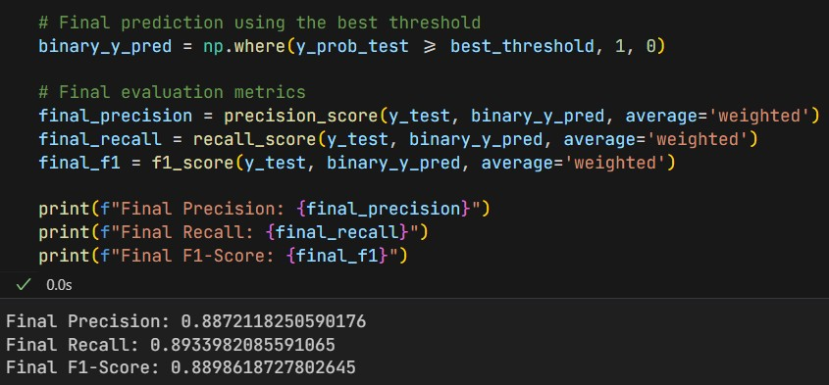
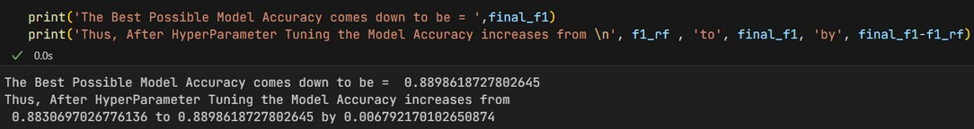
RESULTS AND FINDINGS
As discussed earlier, classifier has been used, so precision, recall and F1-score has been used as points of evaluation for the final findings.
After hyper-parameter Turing, the final accuracy has increased from 0.88306 to 0.88986, thus increasing it by 0.0067

